Slide 1

Data Science Capstone Project
Objective: Locate Suitable investment site for City Centre Wine Bar

Slide 2
Introduction
Determine if a suitable location exists for potential investors in a new City Centre Wine Bar.
The key requirements are:
1) to avoid existing competition, a location must not have too many alternatives within a close vicinity
2) positioning in a prime location to maximise the amount of customers to the wine bar
3) must be based within Manchester (UK) City Centre catchment area

Slide 3
DATA
Foursquare data will be used to identify all existing competition.
A suitable location radius will be identified using folium maps to illustrate the target sites.

Slide 4
Methodology
Use Foursquare API to search the specific venue category for Wine Bars (search categoryID{})
Visualise the areas of current competition on a Folium map
Identify a potential area which avoids competition, while remaining central and positioned to a large number of potential customers

Slide 5
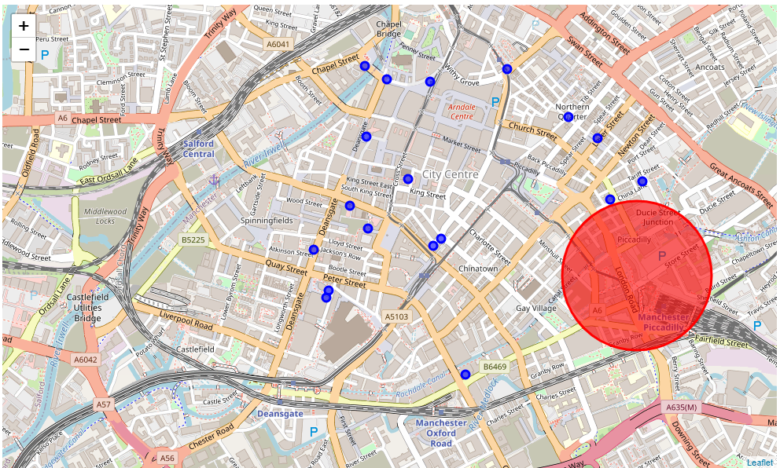
Results
Results identified 17 potential competitors
Target location identified close to Manchester Piccadilly Train Station

Slide 6
Discussion
A considerable number of Wine Bars already exist within the City Centre, therefore choosing the correct location will be critical to success
A large opportunity would seem to be available to capture travelling train passengers leaving Manchester Piccadilly Train Station, before they reach the competition locations.
While the Christmas market is taking place, average passenger numbers at Manchester Piccadilly station rise by up to 40,000 each day, peaking at 160,000 in total.
That’s compared to the average of 120,000 passengers using the station daily during the rest of the year.
In summary; a significant volume of potential customers in this area.

Slide 7
Conclusion
While a number of competitors exist within the City Centre, a location targeting the pedestrian traffic close to Manchester Piccadilly Train Station was chosen
The site benefits from no competition with 10 minutes walking distance
The large amount of daily train passengers using Manchester Piccadilly will represent an excellent opportunity to generate sufficient sales from passing customers, those looking to relax after or before commuting, or a place to wait while transport is delayed.

